Slide 1
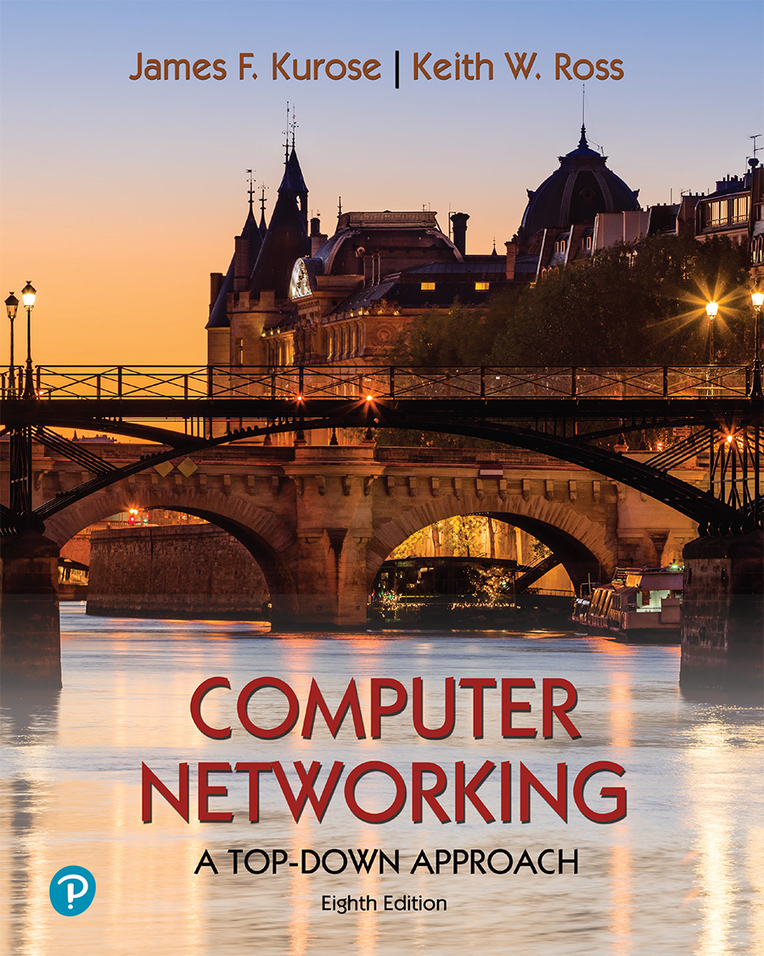
Chapter 8 Security
A note on the use of these PowerPoint slides:
We’re making these slides freely available to all (faculty, students, readers). They’re in PowerPoint form so you see the animations; and can add, modify, and delete slides (including this one) and slide content to suit your needs. They obviously represent a lot of work on our part. In return for use, we only ask the following:
If you use these slides (e.g., in a class) that you mention their source (after all, we’d like people to use our book!)
If you post any slides on a www site, that you note that they are adapted from (or perhaps identical to) our slides, and note our copyright of this material.
For a revision history, see the slide note for this page.
Thanks and enjoy! JFK/KWR
All material copyright 1996-2023
J.F Kurose and K.W. Ross, All Rights Reserved
Computer Networking: A Top-Down Approach 8th edition Jim Kurose, Keith Ross Pearson, 2020
Notes:
Version History
8.0 (May 2020)
All slides reformatted for 16:9 aspect ratio
All slides updated to 8th edition material
Use of Calibri font, rather that Gill Sans MT
Add LOTS more animation throughout
lighter header font
wireless security completely redone (updated WiFi and added 4G/5G)
SSL material replaces by TLS 1.3 (up-to-date)
V8.2 (Feb 2022)
Minor corrections

Slide 2

Chapter 8 outline
What is network security?
Principles of cryptography
Authentication, message integrity
Securing e-mail
Securing TCP connections: TLS
Network layer security: IPsec
Security in wireless and mobile networks
802.11 (WiFi)
4G/5G
Operational security: firewalls and IDS
Blockchain

Slide 3
Blockchains
What it allows:
Two strangers can complete a transaction without a third party
1st Generation: Transaction = Money transaction
2nd Generation: Contracts, Agreements, Property, …
Revolutionizing and changing how we do banking, manufacturing, education, computer networking, …
How is it done?
A singly linked chain of blocks of verified, signed transactions is replicated globally on millions of nodes
You will have to change millions of nodes to attack/change

Slide 4
Examples of Centralized Systems
Banks: Allow money transfer between two accounts
Currency: Printed and controlled by the government
Stocks: Need brokers and clearing house (NY Stock Exchange, Bombay Stock Exchange, etc.)
Credit Card companies
In all cases:
There is a central third party to be trusted
The central party maintains an extensive database of information
⇒ Attracts Hackers
The central party may be hacked
⇒ affects millions
The central party is a single point of failure. It can malfunction or be bribed.
http://www.cse.wustl.edu/~jain/cse570-23/

Slide 5
Trend: Centralized to Decentralized
Trend: Make everything decentralized with no central point of control
You can send money to your friends in Russia and China without their governments knowing it
You can make a wedding contract, Property contract
Decentralized systems are
More reliable: Fault-tolerant
More secure: Attack tolerant
No single bottleneck ⇒ Fast
No single point of control ⇒ No monopoly ⇒ Cheaper
Libertarians decided to build a decentralized system with no central authority. Blockchain is one way to do this.

Slide 6
Bitcoin
First Successful Virtual Currency
Has survived 11 years and has become legal in several jurisdictions
Decentralized: No one company or government controls it
Decentralized Transaction Verification
Decentralized Ledger (accounting book)
Decentralized Mint to make new coins
Decentralized peer-to-peer network
Has been designed to control over-minting, double-spending, counterfeiting
A total of 21 Million BTC will be generated.

Slide 7
Bitcoin History
Satoshi Nakamoto published a whitepaper in 2008. How to do a direct transfer of money without involving a 3rd party.
He also published a complete reference code to transact, store, and mint Bitcoins. Made the software open source.
He supported the software and answered all questions for three years and then disappeared
(maybe because he was rich or fearful)
P2P Network:
Nodes come up and leave at random
Packets are delayed, lost, duplicated
Some nodes are malicious
As long as a majority of CPU power is not with attackers, the system works ⇒ Proof of Work
Ref: Satoshi Nakamoto, “Bitcoin: A Peer-to-Peer Electronic Cash System,” https://Bitcoin.org/Bitcoin.pdf

Slide 8

Hash Function
Hash tables used in data searches
The hash function should
Data
Student Questions
How are hash functions applied in practice? Hash functions are used routinely for storing sparse data, e.g., SSN to bank a/c number table.
Take variable size input
Produce fixed output size (Size of the table)
Be easy to compute
Be pseudorandom so that it distributes uniformly over the table ⇒ Minimizes collisions
Deterministic: The same input always produces the same hash
Example: h(M) = M mod 9; M=13 ⇒ h(M)=4
Hash Fn
http://www.cse.wustl.edu/~jain/cse570-23/

Slide 9
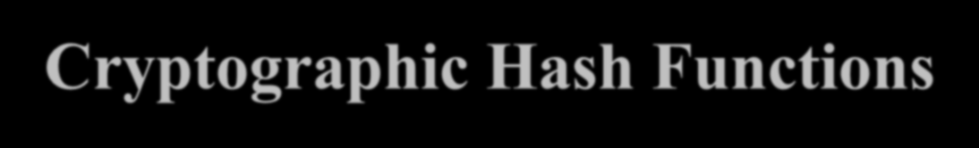
Cryptographic Hash Functions
One-way
It is not possible to find any M, given h.
Very Very difficult to compute M given h(M)
SHA-2: Secure Hash Algorithm standardized by the National Institute of Standards and Technology (NIST).
SHA-256 produces a 256-bit hash of any number
RIPEMD: RACE Integrity Primitive Evaluation developed in the EU
RIPEMD160 produces a 160-bit hash
Student Questions
Are SHA-2 and SHA256 the same? Or is it that SHA-2 has variable length options, and one can be 256 bits?
SHA-2 is the 2nd version of SHA. All versions are used with different key lengths. Users indicate their key length after SHA. So, SHA-256 is SHA with a 256-bit key. There is clarity since version numbers are 1, 2, or 3. Keys are 512+.
http://www.cse.wustl.edu/~jain/cse570-23/

Slide 10

Secret Key Cryptography
Secret Key Cryptography:
Encrypted Text Plain Text
Student Questions
Plain Text
Encrypted Text
Key
Key
The key must be kept secret.
Anyone with the key can read/write/change messages.
http://www.cse.wustl.edu/~jain/cse570-23/

Slide 11

Public Key Encryption
Invented in 1975 by Diffie and Hellman at Stanford
Encrypted_Message = Encrypt(Key1, Message)
Message = Decrypt(Key2, Encrypted_Message)
Key1 Key2
Student Questions
Do all encryption actions in blockchains
use public keys?
Yes, for public blockchains. There can always be exceptions in private blockchains.
You mention a private
blockchain in response to an older answer on this slide: what is such a private blockchain, and why would you use a private key regardless?
Many banks have joined together to form private blockchains. These chains have many but limited
miners, and only authorized servers can mine. This reduces the overhead.
Text Ciphertext
Keys are interchangeable:
Key2 Key1
Text
Text Ciphertext
One key is made public, while the other is kept private
Sender knows only the public key of the receiver ⇒
Asymmetric
Ref: http://en.wikipedia.org/wiki/Public-key_cryptography
Text
http://www.cse.wustl.edu/~jain/cse570-23/

Slide 12
Public Key Encryption
Invented in 1975 by Diffie and Hellman at Stanford
Encrypted_Message = Encrypt(Key1, Message)
Message = Decrypt(Key2, Encrypted_Message)
Key1 Key2
Student Questions
Could you tell me more about the public key/private key? I don't know about cryptography.
A secret key is used in cryptography to encrypt and decrypt.
For example, division by 9 Encrypt(123)=136 because 123/9=13 and 6 is the remainder
Decrypt(136)=13*9+6=123 Here, 9 is the secret key shared by the sender and receiver.
An example of public key
encryption would be for both sender and receiver to use two keys each. If you use one key for encryption, it can be decrypted only by the second key.
Text Ciphertext
Keys are interchangeable:
Key2 Key1
Text
Text Ciphertext
One key is made public, while the other is kept private
Sender knows only the public key of the receiver ⇒
Asymmetric
Ref: http://en.wikipedia.org/wiki/Public-key_cryptography
Text
http://www.cse.wustl.edu/~jain/cse570-23/

Slide 13









Public-Key Authentication and Secrecy
B’s Public Key
A’s Private Key
A
Message
B
Student Questions
Why is it encrypted twice? Isn't it possible to encrypt with B's public key once and then send it to B? Because only B knows B's private key.
The First encryption ensures that it came from A.
Decentralization means no central system holds our private keys, which cannot be retrieved if we lose them. Does that mean it’s too risky to use blockchain technologies in real life widely?
Yes, if you lose the private key, you lose the safe. But it is not considered risky. All private keys are not held by anyone else. Private keys are in wide use.
How do companies defend against attacks in cryptography?
Cryptography is designed to be attack-proof.
A encrypts the message with its private key and then with B’s public key
B can decrypt it with its private key and A’s public key
No one else can decrypt ⇒ Secrecy
No one else can send such a message
⇒ B is assured that the message was sent by A
⇒ Authentication
http://www.cse.wustl.edu/~jain/cse570-23/

Slide 14

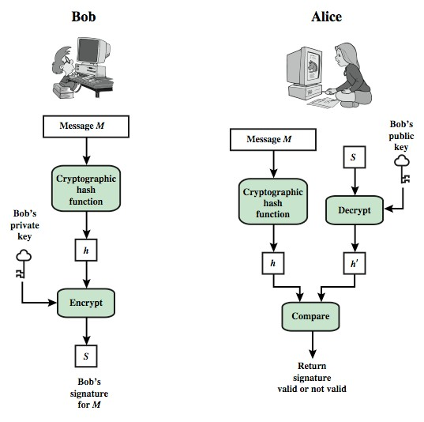
Digital Signature
Student Questions
The figure on the left explains the sending process, whereas the right figure is for the receiver side. Correct?
Yes.
To double confirm, does Hashing the msg have nothing to do with signing? It is just for the msg integrity but not for authenticating the sender? as digital signature is purely related to public-key cryptography.
Hashing the message is required for signing. The signature length is equal to the size of the item being signed. Hashing reduces the length of the signature. Otherwise, the signature would be the same length as the message.
http://www.cse.wustl.edu/~jain/cse570-23/

Slide 15


Transaction
Bob gives 1 BTC to Alice
I (Bob) give 1 BTC to Alice
Hash of previous transaction of this coin
Hash
Bob’s Public Key
Bob signs with his private key
Address of Alice
Signed Transaction and Bob’s public key

Slide 16
Blocks
Transaction Chain:
Transaction
Transaction
Transaction
Transaction
Problem:
Too many transactions ⇒ Chain too long
Takes too long to find and verify a transaction
Solution: Combine several transactions into blocks of verified transactions
Time Stamp
Transaction Transaction
Transaction Transaction
Transaction
Block 0
Time Stamp
Transaction Transaction
Transaction Transaction
Transaction
Block n-1
Time Stamp
Transaction Transaction
Transaction Transaction
Transaction
Block n

Slide 17
Blockchains
Block maker (Miners) ensures that all transactions in the block are valid
Miners have significant computing power
The miner with the highest computer power w Their block is added to the end of the chain
Miner is rewarded.
They are allowed to mint a few new coins and keep them
Proof of computing power ⇒ Proof of work
⇒ Solve a puzzle
The chain with the highest cumulative difficulty is selected as the main chain
ins.

Slide 18
Bitcoin Address
Addresses=RIPMD160(SHA-256(Public Key))
Addresses are encoded with Base-58 encoding
(10 digits + 26 uppercase + 26 lowercase – 4 (0, O, 1, I) that is, lowercase L and uppercase I
Base58 Check Encoding: 4-byte checksum is appended. Checksum=First 4 bytes of SHA256(SHA256(Prefix+Data)
Prefix is 0x00 = version
After encoding, a one is added to indicate that it is an address
Always start with 1
Generally presented as a QR Code
http://www.cse.wustl.edu/~jain/cse570-23/

Slide 19
Pseudo-anonymous
Using a nonce, you can generate a new public/private key pair
RIPMD160 of SHA-256 hash of the public key is your address
All transactions are between two addresses
You can have as many addresses as you like
You do not need to disclose your name, ID, or physical address
⇒ Pseudo anonymous
If a transaction touches the physical world, your identity is disclosed, e.g., when buying your first Bitcoin with your credit card

Slide 20

Current Blockchain Process
Users broadcast transactions or smart contracts
Mining nodes validate transactions and create blocks
Blockchain nodes validate blocks and construct a chain
There are many users, many mining nodes and many blockchain nodes.
More nodes ⇒ Better.
Less ⇒ Blockchain not required/useful.
http://www.cse.wustl.edu/~jain/cse570-23/

Slide 21

Proof-of-Work (PoW)
When someone requests a service, ask them to do something difficult for the requester but easy to verify for the server. Captcha is one example
Bitcoin requires proof that you can compute faster than others
A puzzle is given, and the node that solves it first wins
Puzzle is such that it can be solved in ~ 10 minutes
⇒ Puzzles are being made more challenging as the computing power increases with Moore’s Law.

Slide 22
Puzzle
Find a nonce that will make the hash of the block header less than a specified target
Lower target ⇒ More challenging to find
A puzzle can be made harder/easier by specifying a higher or lower target
Target is adjusted by all miners every two weeks (2016 blocks),
so it takes 10 minutes to solve the puzzle.
+2²⁵⁶-1
Target or difficulty
Block Header Nonce
Hash
0

Slide 23
Block Structure
Block header contains a double-hash of the previous block header, a hash of the root of the Merkle tree of transactions in the block, a time stamp, difficulty, nonce
Previous Block Header Hash Timestamp:
Difficulty: Nonce: Merkle Root:
Transactions
Ref: A. M. Antonopoulos, “Mastering Bitcoin,” O’Reilly, 2015, 274 pp.

Slide 24
Merkle Tree
A Binary hash tree to efficiently summarize and verify the integrity of large sets of data
Hashes of the transactions are stored in the tree
Parents contain the hash of the concatenation of children
Takes log₂(n) comparisons to find the transaction among n
Hash(HT12 || HT34)
Hash(HT1 || HT2)
Hash(HT3 || HT4)
Hash(T1) | Hash(T2) | Hash(T3) | Hash(T4)
Ref: A. M. Antonopoulos, “Mastering Bitcoin,” O’Reilly, 2015, 274 pp.

Slide 25
Smart Contracts
Bob: I give $100 to Alice if IBM stock goes below $5
Locking script: if IBM stock < $5, Return True
Unlocking script: IBM stock price is $4
Property exchange happens if certain conditions are satisfied. Conditions can be checked automatically
⇒ Allows trustless exchanges
Smart Contracts: Not just buy/Sell. Any agreement.
http://www.cse.wustl.edu/~jain/cse570-23/

Slide 26
Potential Blockchain Applications
Financial: Currency, Private equities, Public Equities, Bonds, Derivatives, Commodities, Mortgage records, Crowd-funding, Micro-finance, Micro-charity
Public Records: Land titles, Vehicle registries, Business licenses, Criminal records, Passports, Birth certificates, Death certificates, Building permits, Gun permits
Private Records: Contracts, Signatures, Wills, Trusts, Escrows
Other Semi-Public Records: Degree, Certifications, Grades, HR records, Medical records, Accounting records
Physical Asset Keys: Apartment keys, Vacation home keys, Hotel room keys, Car keys, Rental car keys, Locker keys
Intangibles: Patents, Copyrights, Trademarks
Ref: http://ledracapital.com/blog/2014/3/11/Bitcoin-series-24-the-mega-master-blockchain-list

Slide 27
Networking Applications of Blockchains
Multi-Domain Systems:
Multiple Cloud Service Providers
Multiple cellular providers
Multi-Interface devices: WiFi, Cell, Bluetooth, …
BGP: BGP Authentication
Globally Centralized Systems:
DNS
Certificate Authorities
Explore blockchains for multi-domain/centralized systems

Slide 28
Public Key Infrastructure
Certificate Authorities issue certificates
Single Point of Failure
CA Keys are often compromised
(Diginotar – Dutch certificate authority was compromised in 2011)
Web of Trust: Anyone can issue a certificate
Blockchain solution: Store user ID and public key
Blockstack
Certcoin

Slide 29
Data Provenance
Keeping track of the origin and history of the movement of data among the databases or documents
Traditional solution: Logging and auditing
In a distributed cloud environment, centralized logging is required and is difficult
Blockchains can be used to log the changes Miners verify the changes
ProvChain
SMARTDATA
Also used in supply chains
http://www.cse.wustl.edu/~jain/cse570-23/

Slide 30
Data Privacy
Facebook and Google have massive amounts of personal information
Who can access this information?
Can someone do statistics on the database without having the rights to all personal information?
Can the user hide their identity?
Traditional Method: Access Control Lists (ACL) managed centrally (by Facebook and Google)
Blockchains can be used to keep ACL and data stored in a distributed manner with no central control

Slide 31
Data Integrity
Data has not been corrupted
Traditional techniques: Digital Signatures and PKI, Replication
In blockchains, data can not be tempered once committed to a block.
Ericson provides a blockchain-based integrity assurance service
http://www.cse.wustl.edu/~jain/cse570-23/

Slide 32
Blockchain Challenges
Selfish mining: Someone creating a large number of bad blocks, keeping the validators busy with discards
Sybil Attacks: Someone creating a large number of transactions denying service to legitimate users
51% Attack: One entity owns the majority of miners
Communication overhead
Solving the puzzles for “Proof of Work” wastes computing resources
http://www.cse.wustl.edu/~jain/cse570-23/

Slide 33
Blockchain Challenges
Selfish mining: Someone creating a large number of bad blocks, keeping the validators busy with discards
Sybil Attacks: Someone creating a large number of transactions denying service to legitimate users
51% Attack: One entity owns the majority of miners
Communication overhead
Solving the puzzles for “Proof of Work” wastes computing resources
Washington University in St. Louis
17.33b
http://www.cse.wustl.edu/~jain/cse570-23/

Slide 34
Alternatives to “Proof of Work”
Proof of Space: Computation is replaced by storage
Measure of Trust: Most trustworthy miner wins
Minimum Block Hash (rather than fastest) miner wins ⇒
More random
Proof of Importance
Proof of Stake
http://www.cse.wustl.edu/~jain/cse570-23/

Slide 35
Blockchain Implementations
Open Source Implementations:
Bitcoin
Ethereum
Hyperledger
Commercial Implementations: Block Chain as a Service from
IBM
Microsoft Azure
SAP
Deloitte
http://www.cse.wustl.edu/~jain/cse570-23/

Slide 36
Key Strengths of Blockchains
Distributed: No single point of failure
Decentralized Consensus: Transactions are valid only if agreed upon by the majority
Trustless: Transacting or processing parties do not need to trust
Cryptographic Security: Elliptic Curve Cryptography
Non-Repudiation Guarantee: All transactions are signed
http://www.cse.wustl.edu/~jain/cse570-23/

Slide 37
Summary
The current trend is to make everything decentralized
Bitcoin is a decentralized currency.
Blockchain 1.0 is used for global consensus on Bitcoin transactions.
Blockchain 3.0 allows sophisticated contracts, making it useful for many network and security applications
http://www.cse.wustl.edu/~jain/cse570-23/

